Slide 1


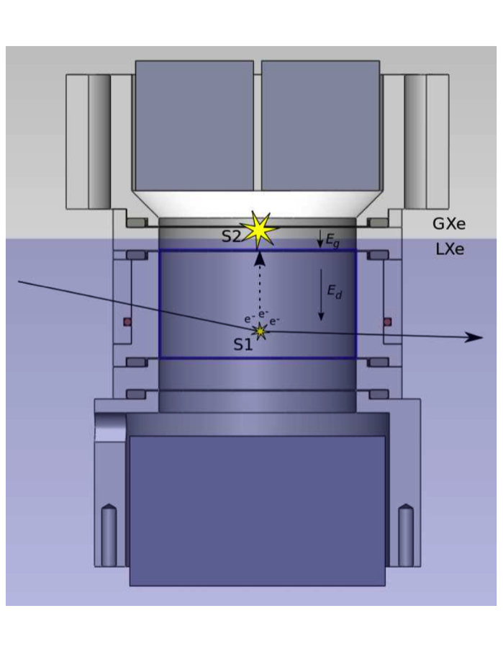
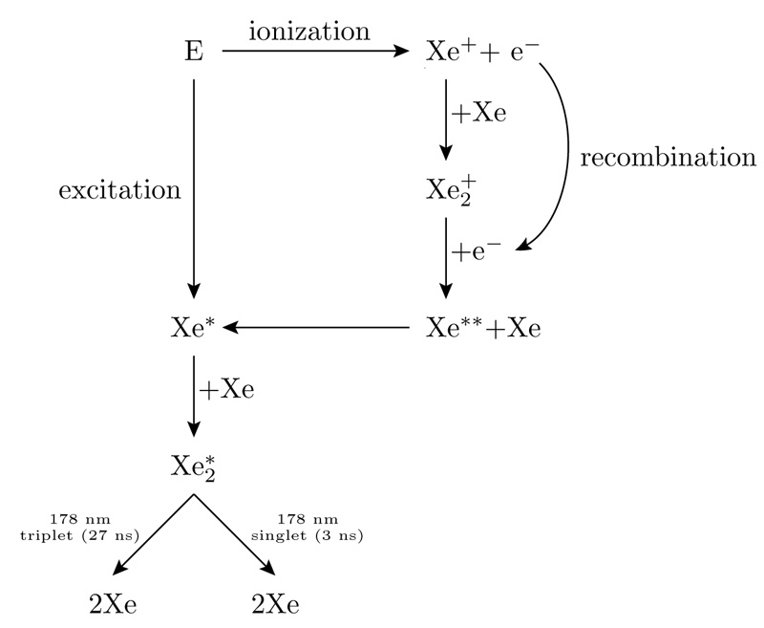
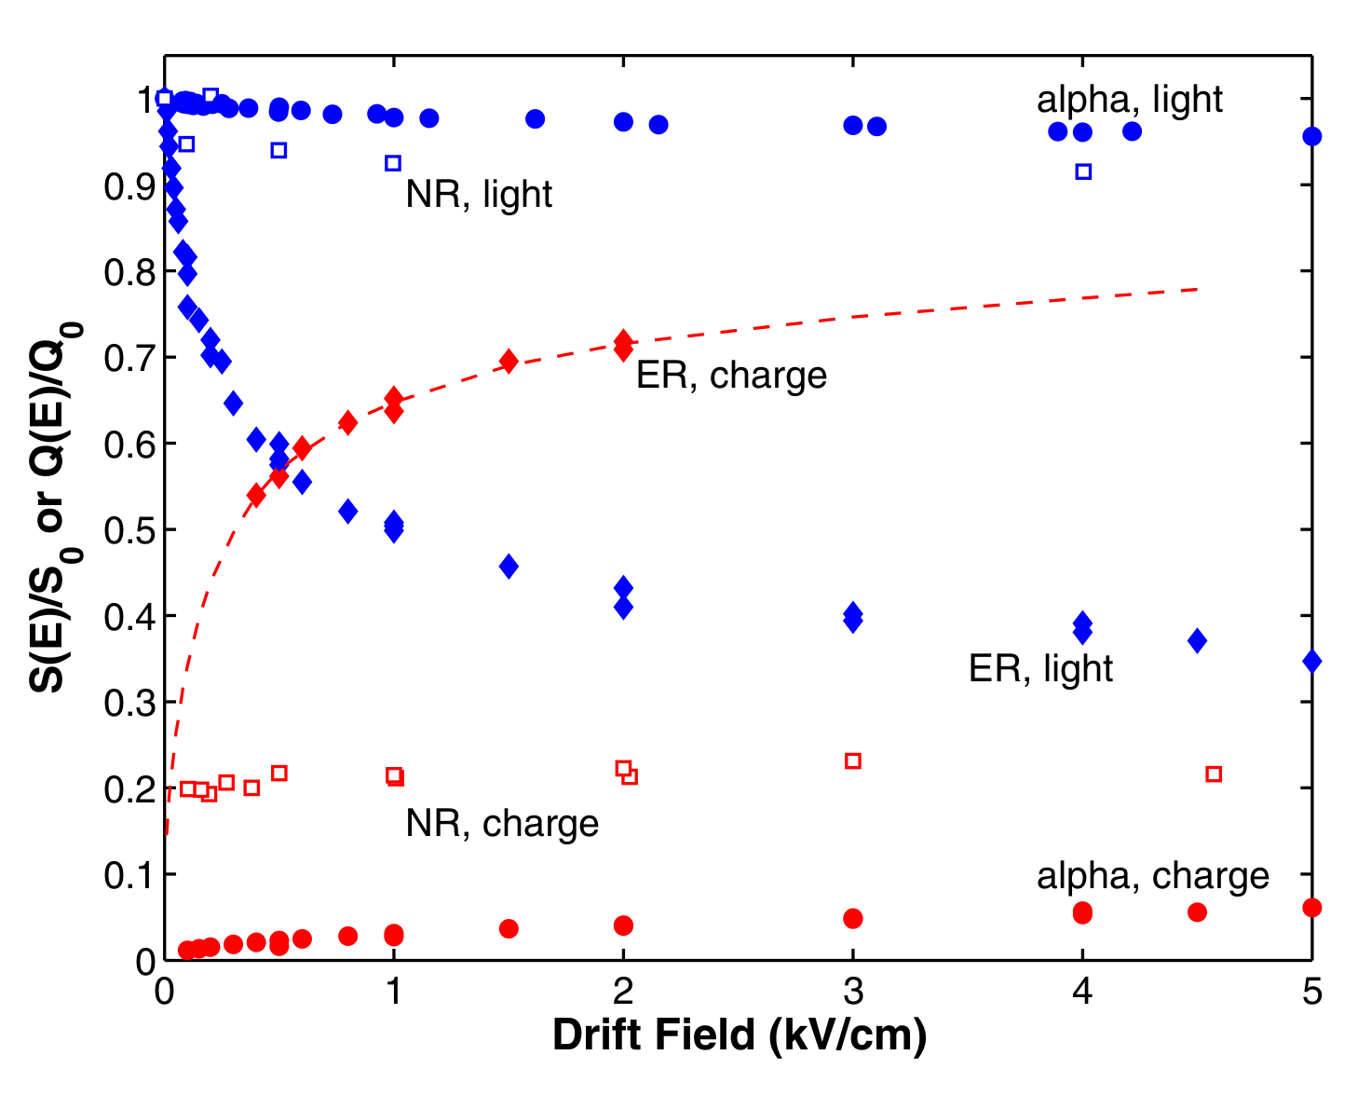
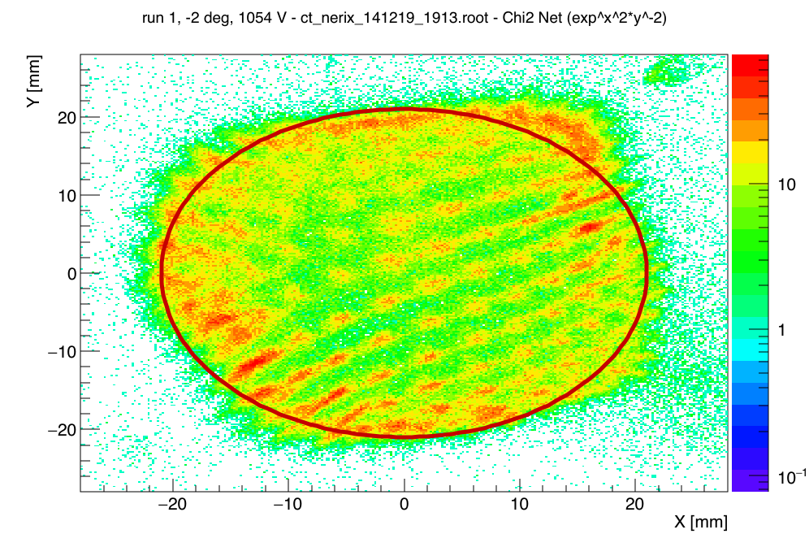
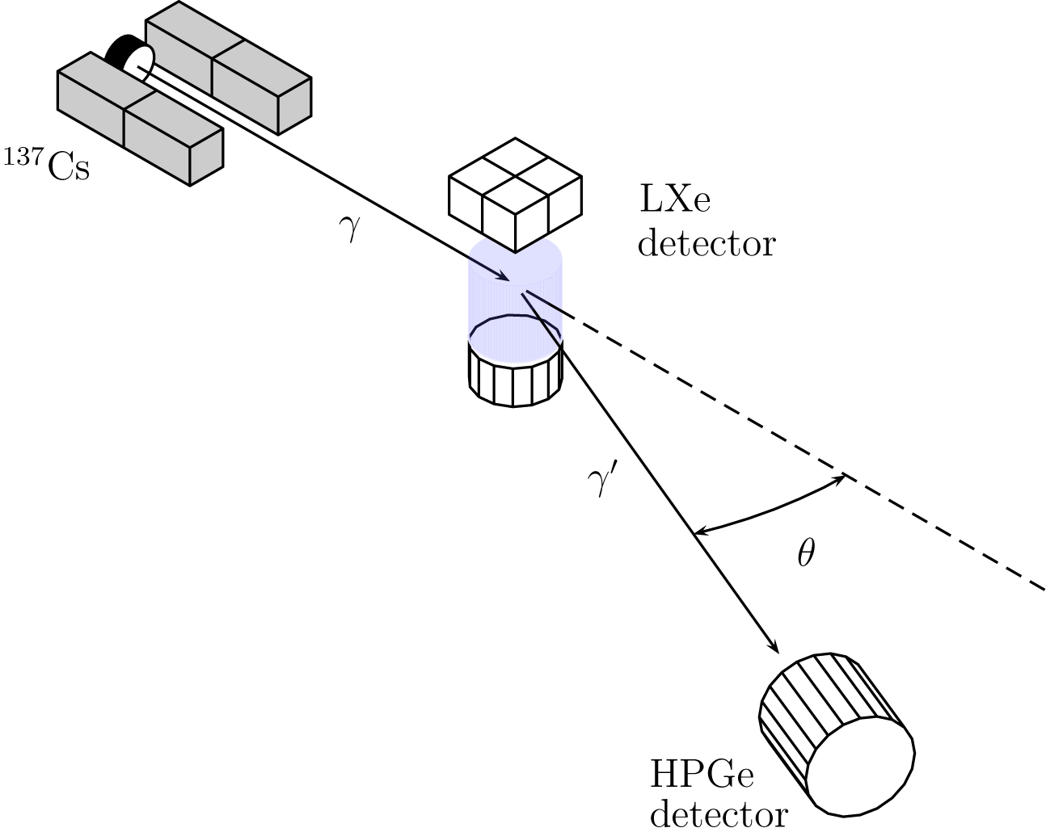
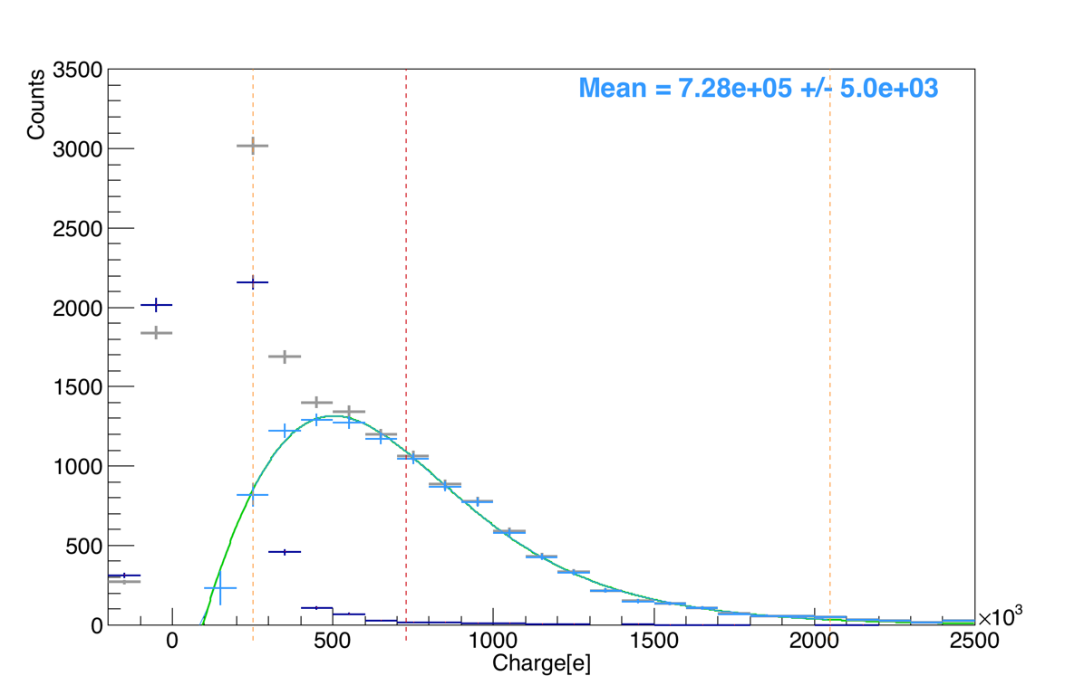
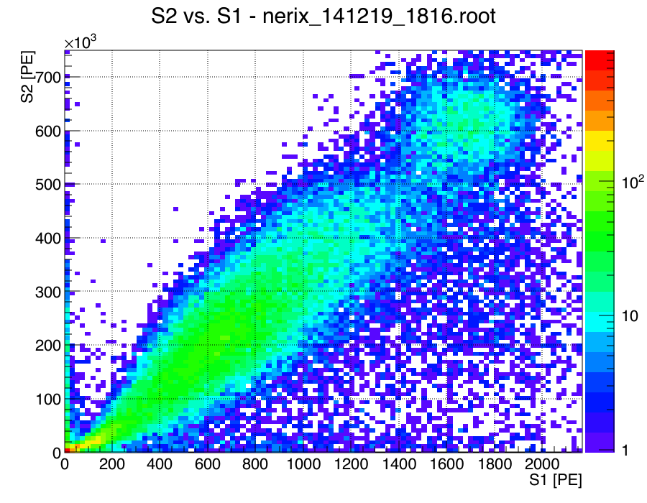
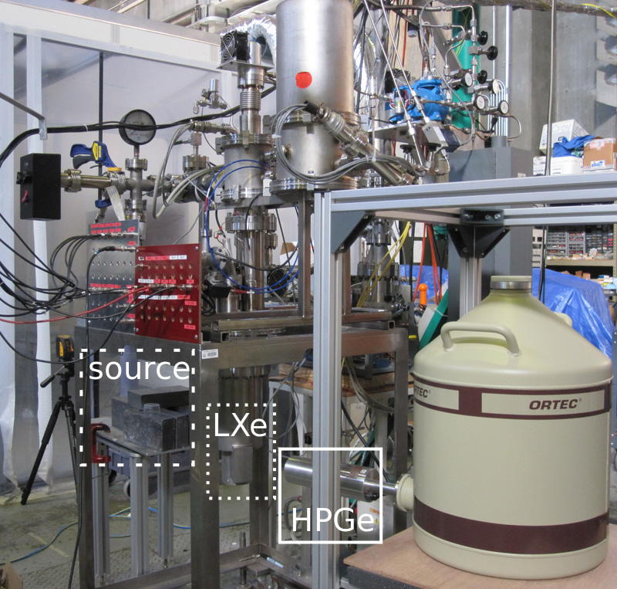
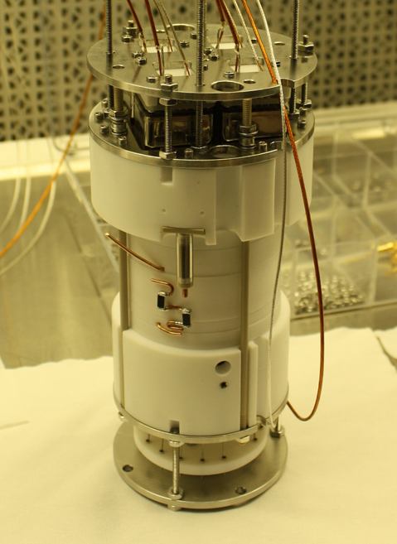
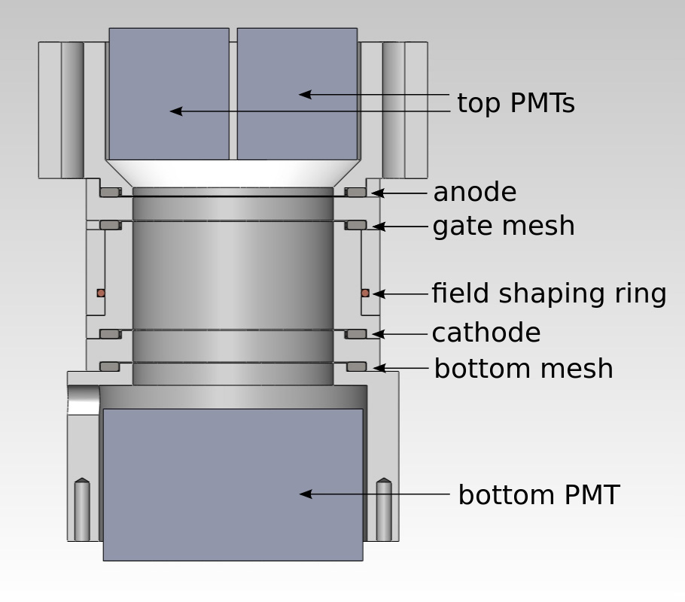
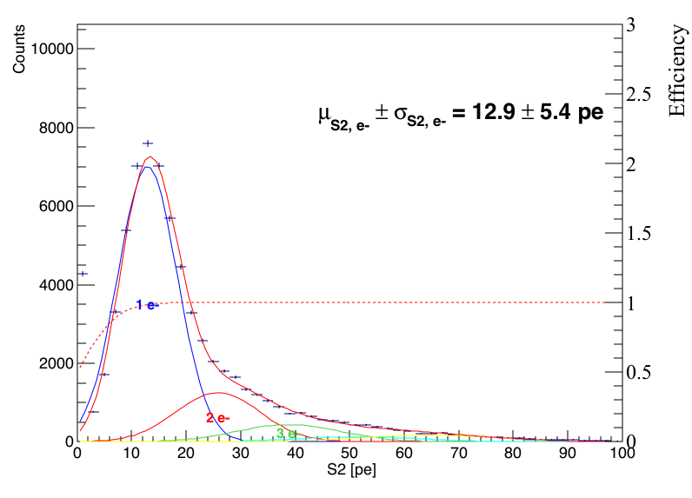
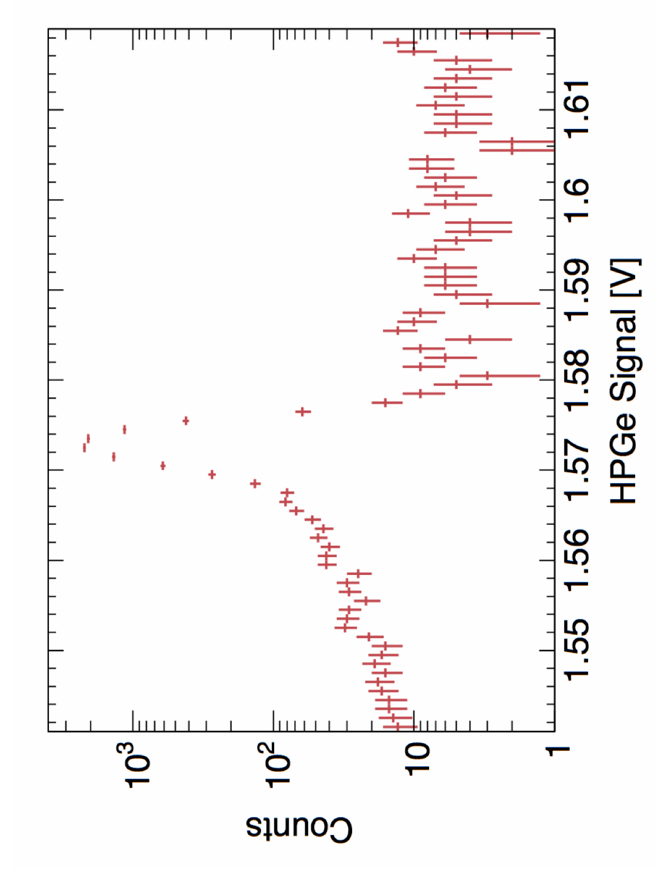


Measurement of the Charge and Light Yield of Low Energy Electronic and Nuclear Recoils in Liquid Xenon at Different Electric Fields
M. D. Anthony¹, E. Aprile¹, L. W. Goetzke¹, G. Plante¹, and M. Weber¹
1. Columbia University, New York, NY
Dual-Phase LXe Detectors
Light and Charge Yield
Dual-phase LXe detectors ➔ simultaneous detection of light and charge
S1: Prompt light emission from interaction in LXe
S2: Complementary signal from acceleration of electrons through GXe
Light and charge yield non-linear in energy and drift field
Light Yield = Photoelectrons / Energy
Charge Yield = Free Electrons / Energy
Light and Charge Yield vs. Drift Field
Leads to S2 if remains free
S1
S1
Given an electronic or nuclear recoil at a certain energy in a drift field, how much light and charge do you expect to be produced?
neriX Detector
Position Reconstruction
Compton Coincidence Technique
Dual-phase LXe Time Projection Chamber for measuring nuclear and electronic recoils in Xenon
Small size and minimal materials surrounding fiducial volume make this detector well suited for measurements of light and charge yield
Can measure light and charge yield as a function of energy and drift field
Photons Compton scatter in LXe then deposit remaining energy in HPGe detector
SPE Gain Distribution
Cs-137 Spectra in LXe and HPGe
Single Electron Gain
Prompt Scintillation Light (S1) vs. Energy Deposited in LXe
Preliminary Electronic Recoil Results
By taking slices of 1 keV in the recoil energy vs. S1 and S2 spectra we can determine the light and the charge yield respectively
Expected anti-correlation present
Results shown are preliminary – light and charge yields were both measured down to 1 keV
Light Yield vs. Recoil Energy
Charge Yield vs. Recoil Energy

